Slide 1

Gainesville Police Department
Traffic Homicides with Fatalities
Five Year Review
2019 – 2023
20
Prepared by: Mary Vaught
Date: 2/28/24

Slide 2
2019-2023: Traffic Crash Fatalities
YEAR | THI
2019 | 16
2020 | 16
2021 | 22
2022 | 24
2023 | 20
Traffic Homicide Investigations “THI” (Actual Loss of Life)
Over the past five years, there has been an average of 19.6 deaths per year involving vehicles. The City went from 16 fatalities in 2019 to a high of 24 (+50%) in 2022, then ended 2023 close to the average at 20.
Notes:
Previous years review

Slide 3

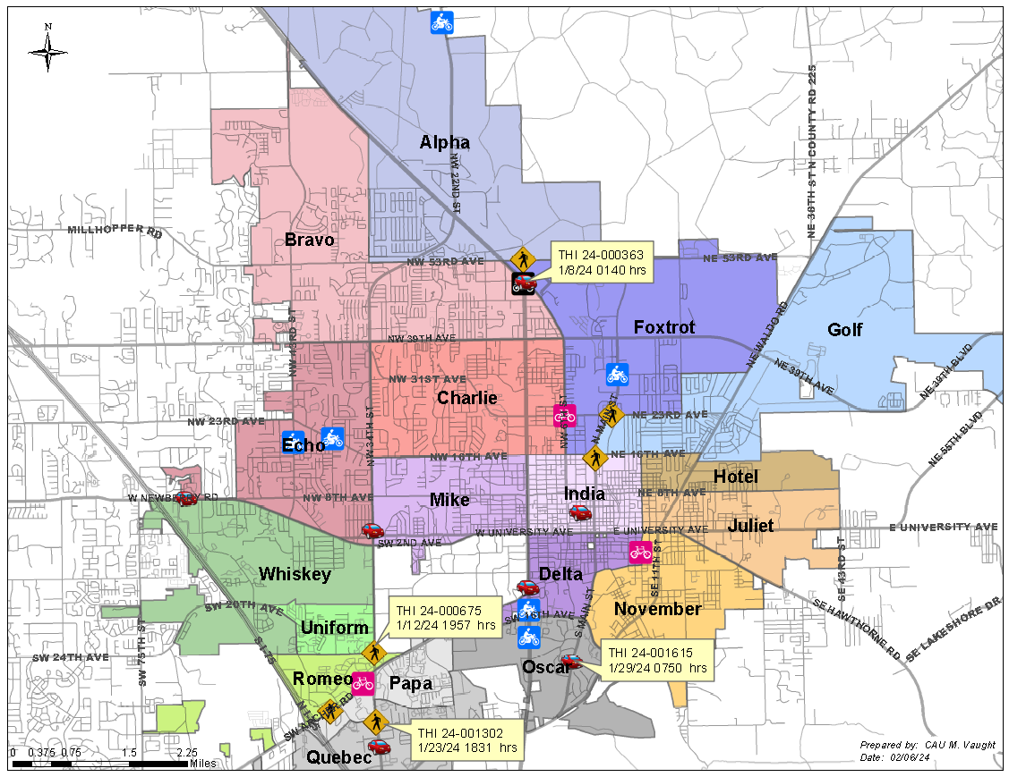
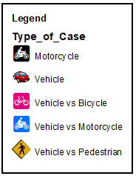
2023 Fatalities and January 2024
Notes:
Change map

Slide 4
2019 Traffic Fatalities
Type of Case | 2019
Vehicles Only | 3
Vehicle vs Bicycle | 0
Vehicle vs Motorcycle | 5
Vehicle vs Pedestrian | 7
Vehicle vs Scooter | 0
Vehicle vs Semi | 1
Total for Year | 16
There were 16 accidents where 16 victims died. 7 out of 16 (%) involved Pedestrians. 7 out of 16 (46%) were between the ages of 11 and 30 yoa.
Age of Victims | 0-10 | 11-20 | 21-30 | 31-40 | 41-50 | 51-60 | 61-70 | 71-Over
THI Victims | 0 | 3 | 4 | 2 | 2 | 3 | 1 | 1

Slide 5
2020 Traffic Fatalities
Type of Case | 2020
CMV/Bus vs. Ped | 2
Vehicles Only | 4
Vehicle vs Bicycle | 1
Vehicle vs Motorcycle | 2
Vehicle vs Pedestrian | 5
Vehicle vs Scooter | 1
Vehicle vs Semi | 1
Total for Year | 16
There were 16 accidents where 16 victims died. 5 out of 16 (%) involved Pedestrians. 7 out of 16 (46%) were over the age of 61.
Age of Victims | 0-10 | 11-20 | 21-30 | 31-40 | 41-50 | 51-60 | 61-70 | 71-Over
THI Victims | 0 | 4 | 2 | 1 | 2 | 0 | 4 | 3

Slide 6
2021 Traffic Fatalities
Type of Case | 2021
Motorcycle Only | 1
Vehicles Only | 9
Vehicle vs Bicycle | 2
Vehicle vs Motorcycle | 2
Vehicle vs Pedestrian | 7
Vehicle vs Scooter | 1
Total for Year | 22
There were 22 accidents where 22 victims died. 7 out of 22 (32%) involved pedestrians. 6 out of 22 (27%) were over the age of 71.
Age of Victims | 0-10 | 11-20 | 21-30 | 31-40 | 41-50 | 51-60 | 61-70 | 71-Over
THI Victims | 2 | 4 | 4 | 2 | 0 | 2 | 2 | 6

Slide 7
2022 Traffic Fatalities
Type of Case | 2022
Motorcycle vs Pedestrian | 1
Vehicles Only | 7
Vehicle vs Bicycle | 1
Vehicle vs Motorcycle | 6
Vehicle vs Pedestrian | 8
Vehicle vs Scooter | 1
Total for Year | 24
There were 24 accidents where 24 victims died. 7 out of 24 (29%) involved motorcycles. 11 out of 24 (46%) were over the between 21 and 40 yoa.
Age of Victims | 0-10 | 11-20 | 21-30 | 31-40 | 41-50 | 51-60 | 61-70 | 71-Over
THI Victims | 0 | 1 | 5 | 6 | 3 | 2 | 4 | 3

Slide 8
2023 Traffic Fatalities
Type of Case | 2023
Motorcycle Only | 1
Vehicles Only | 5
Vehicle vs Bicycle | 3
Vehicle vs Motorcycle | 7
Vehicle vs Pedestrian | 4
Total for Year | 20
There were 19 accidents where 20 victims died. 8 out of 20 (40%) involved motorcycles. 9 out of 20 (45%) were over the age of 61.
Age of Victims | 0-10 | 11-20 | 21-30 | 31-40 | 41-50 | 51-60 | 61-70 | 71-Over
THI Victims | 0 | 2 | 2 | 5 | 1 | 1 | 5 | 4

Slide 9
2019-2023: THI’s by Case Type
Type of Case | 2019 | 2020 | 2021 | 2022 | 2023 | Totals
Motorcycle Only | 0 | 0 | 1 | 0 | 1 | 2
Motorcycle vs Pedestrian | 0 | 0 | 0 | 1 | 0 | 1
Vehicles Only | 3 | 4 | 9 | 7 | 5 | 28 (29%)
Vehicle vs Bicycle | 0 | 1 | 2 | 1 | 3 | 7
Vehicle vs Motorcycle | 5 | 2 | 2 | 6 | 7 | 22 (22%)
Vehicle vs Pedestrian | 7 | 5 | 7 | 8 | 4 | 31(32%)
Vehicle vs Scooter | 0 | 1 | 1 | 1 | 0 | 3
CMV/Bus vs Pedestrian | 0 | 2 | 0 | 0 | 0 | 2
Vehicle vs Semi | 1 | 1 | 0 | 0 | 0 | 2
Totals | 16 | 16 | 22 | 24 | 20 | 98
Vehicles Only above includes vehicles that hit another vehicle or hit something else. The highest number in one category is 9 which occurred in 2021 for Vehicles Only which has decreased by 2 each year since. Vehicle vs bicycle has increased to 3 in 2023 from 1 in previous years. Vehicle vs Motorcycles has increased the past two years, ending in 7 for 2023. Vehicle vs Pedestrian topped at 8 in 2022 but down to 4(50%) in 2023. The highest number for the 5 years combined was Vehicle vs Pedestrian which was 31 (32%). Vehicle vs. motorcycle is 22 which is 22% of totals. Vehicles only, Veh vs Motorcycle and Veh vs Pedestrian = 83% of total crashes for the City.

Slide 10
2019-2023: THI’s by Case Type
Notes:
Previous years review

Slide 11
2019–2023: THI’s by Highway
Highway Name | 2019 | 2020 | 2021 | 2022 | 2023 | Totals
State Route 24 | 5 | 4 | 3 | 5 | 3 | 20
State Route 26 | 2 | 5 | 7 | 5 | 1 | 20
US 441 SR 25 | 2 | 0 | 1 | 2 | 3 | 8
State Route 121 | 1 | 1 | 1 | 2 | 3 | 8
State Route 329 | 0 | 0 | 1 | 3 | 2 | 6
State Route 222 | 0 | 1 | 3 | 1 | 0 | 5
State Route 20 | 1 | 0 | 1 | 1 | 1 | 4
County Road 120 | 0 | 0 | 1 | 1 | 1 | 3
County Road 30 | 0 | 1 | 1 | 1 | 0 | 3
County Road 232 | 1 | 0 | 0 | 0 | 1 | 2
State Route 331 | 1 | 1 | 0 | 0 | 0 | 2
County Road 172 | 1 | 0 | 0 | 0 | 1 | 2
County Road 2053 | 1 | 0 | 0 | 0 | 1 | 2
State Route 120 | 0 | 0 | 1 | 0 | 0 | 1
N/A (Other roadways) | 1 | 3 | 2 | 3 | 2 | 11
Totals | 16 | 16 | 22 | 24 | 20 | 97
41% of THI deaths have occurred on State Route 24 and State Route 26 over the past five years.

Slide 12
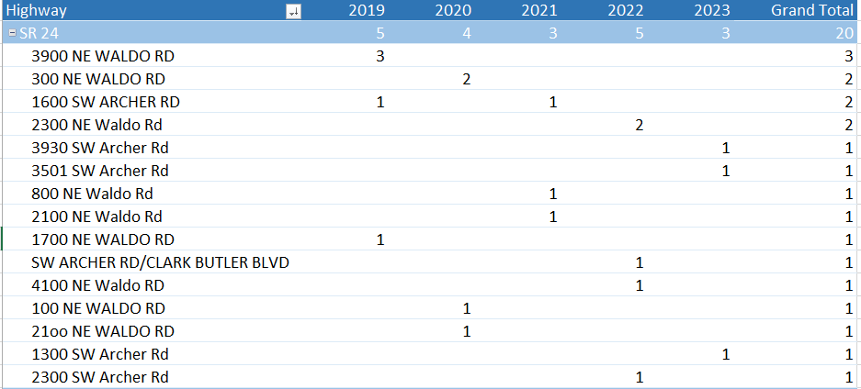
2019-2023: Top Highways – SR 24
There are two roadways that have the same number of accidents for the past five years. The first is State Route 24 which includes Archer Rd and Waldo Rd. Twenty THI’s occurred on this highway which is 21% out of the 97 total accidents. The most in one location was at 3900 NE Waldo Rd which occurred in 2019 and none since.

Slide 13
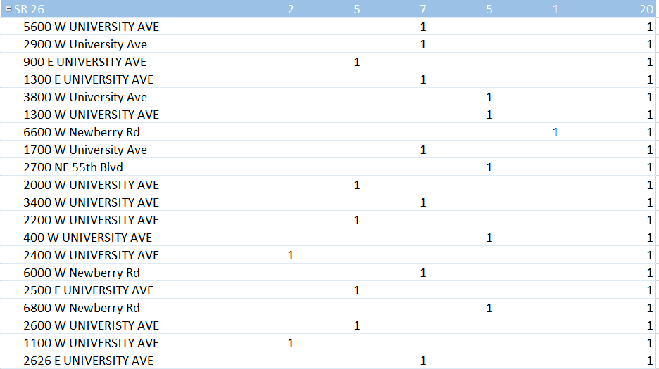
2019–2023: Top Highways – SR 26
The second is State Route 26 which includes East and West University Avenue along with W Newberry Rd. Twenty THI’s occurred on this highway which is 21% out of the 97 total accidents. There is no location that had more than one during these years and only one incident reported in 2023.

Slide 14
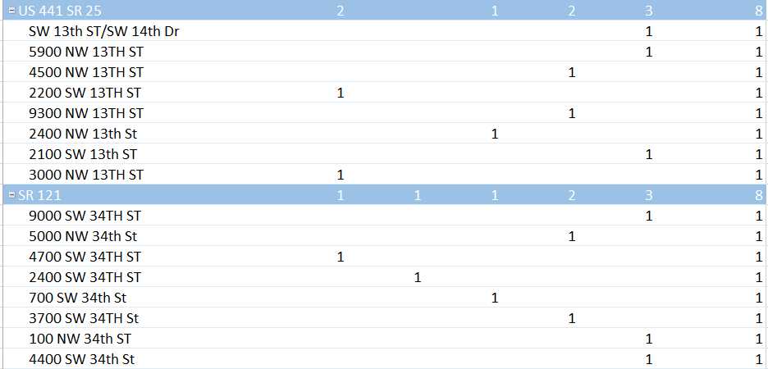
2019-2023: Top Highways – 13th St/34th St
The third/fourth highways will be 13th St (US 441/State Route 25) and 34th St (State Route 121).
Both of these highways have increased from a low of zero to a high of three in 2023 on each roadway.

Slide 15
2019-2023: THI’s by Victim’s Age
Age of Victims | 0-10 | 11-20 | 21-30 | 31-40 | 41-50 | 51-60 | 61-70 | 71-Over | Total
2019 | 0 | 2 | 2 | 5 | 1 | 1 | 5 | 4 | 16
2020 | 0 | 4 | 2 | 1 | 2 | 0 | 4 | 3 | 16
2021 | 2 | 4 | 4 | 2 | 0 | 2 | 2 | 6 | 22
2022 | 0 | 1 | 5 | 6 | 3 | 2 | 4 | 3 | 24
2023 | 0 | 2 | 2 | 5 | 1 | 1 | 5 | 4 | 20
Totals | 2 | 14 | 17 | 16 | 8 | 8 | 16 | 17 | 98
Over the past five years, there has been 98 deaths involving vehicles. There are four age groups with a similar number of deaths. Ages 21-30 and 31-40 (21 – 40 yoa) for a total of 33 which is 34%. Ages over 61-70 and 71-Over (61+) also had a total of 33 which is 34%. Victims have been as young as 3 years of age and as old as 91 years of age.

Slide 16
2019-2023: THI’s by Victim’s Age
Agenda Item: 2023-1051A

